Slide 1

Humans in the Loop:
The Critical Role People Play in Advancing Research with Cloud Cyberinfrastructure
Brian D. Voss
Humans Advancing Research in the Cloud
Pervasive Technology Institute
Indiana University

Slide 2
You may ask yourself, well How did I get here?
Let’s go back in time and see how we got here

Slide 3

Fundamental Premise of Users of Technology
Hey man … I just ride ‘em. I don’t know what makes ‘em go.

Slide 4
The origins of HARC – Humans in the IT Loop
In the beginning, computing and support was centralized
Evolution of the technology of computing/IT drove change
Distributed ‘mini-computers’ in the late 70s and early 1980s
Personal computers in the late 80s and 90s
Advent/Advance of parallel/cluster computers in the 90s
Role of central IT also played a part in the development of decentralized/distributed support for computing/IT
(Not usually by design or in the best ways …)

Slide 5
The Rise of Local/Distributed Support
Distributed systems still required support
Best support is that which comes when you yell for it
A model emerged – often organically (feral)
The role of the user (be generally knowledgeable)
The role of local support (technical, but part of the local culture)
The role of central IT
Give users training and tools (online knowledgebase, HelpDesk, etc.)
Support Local Support Providers (training, tier-2 tech, build community
Provide deep support in some areas (e.g., cyberinfrastructure)

Slide 6
Humans in the (Research/Cyberinfrastructure) Loop
Research use of computing/CI has had its own history
National Centers
‘Closet Clusters’
Campus Centralized ‘supercomputers’
People in roles supporting CI use in research vary
Central IT system and application-area experts
Grad students, Post Docs, local staff
Technically interested and astute faculty/researchers

Slide 7
The Premise of the importance of People
The most effective use of technology comes when those who use it are capable of fully understanding its use and application to their challenges
OR …
Those who use it are supported by people who are capable of fully understanding its use and the application to the challenges faced in given disciplines
This latter situation is the focus of the HARC project

Slide 8
Humans in the Loop?
Cyberinfrastructure – defined as comprising “computing systems, data storage systems, advanced instruments and data repositories, visualization environments, and people, all linked together by software and high performance networks to improve research productivity and enable breakthroughs not otherwise possible.”
In 2011, the National Science Foundation Advisory Committee for Cyberinfrastructure (ACCI) Task Force on Campus Bridging published its final report; the need for address and funding of people was articulated https://www.nsf.gov/cise/oac/taskforces/TaskForceReport_CampusBridging.pdf (keyword: humanware)

Slide 9
What that report said about the role of people
“Time and again, at all levels of the acquisition and deployment of information technology through the past several decades, we have seen that without this human component – the people who make all the other components work – investments made in those other components – however significant in amounts! – do not realize their full potential without attention to and investment in the support of their use by scholars.”
“Scholarly productivity and knowledge breakthroughs and discovery, however enhanced they may be by advanced cyberinfrastructure do not reach their full potential without the human element.”

Slide 10
Aye, there’$ the rub …
While the report highlights the importance of the need for funding people, it did leave open the question of where responsibility for its provision would rest – with funding agencies, or with the institutions that received funding?
This key question remains, and further explanation and justification of the role people play is required to lead to better address of this question.

Slide 11

What follows ignores the elephant in the room

Slide 12
A CIO’s view
We spend a $-load of money on buying all the other ‘wares’ in cyberinfrastructure, but are challenged to devote funds to people
Institutions are reluctant for a wide variety of reasons/challenges
Funding agencies (NSF, NIH, etc.) are similarly reluctant
Why is that?
“Stuff” can be purchased with one-time money (though that conveniently ignores the need to eventually replace it)
“People” require ongoing commitment (in most cases) and that kind of money is harder to come by in budgets

Slide 13
What’s happening at US Research Universities
Pressure establishing or sustaining investments in CI
Many priorities for central IT making it very hard to focus on research enablement
Lack of good research-savvy IT leaders (CIO pipeline issues)
Lack of understanding/appreciation for IT/CI among institutional executive leadership (presidents, provosts, CBOs, Boards)
Not helped by a lack of good ROI data for IT/CI investments

Slide 14
Directions from funding agencies (e.g., NSF)
Overall funding reductions due to politics in the US government (though this may be changing …)
A sense that investing in campus infrastructure is something institutions should be funding rather than asking for federal grants
As discussed at length in NSF-funded workshops, growth in national demand for CI facilities is such that the it simply cannot be met in whole by having the NSF increase funding of established CI facilities
Various funding programs establishing a ‘toe in the water’ for cloud credits as a replacement for capital infrastructure
Growing awareness of the need for funding people

Slide 15
Cloud Providers reaching out to researchers
Amazon, Google, Microsoft (Azure), etc.
However, all is not glittering gold …
Tools, documentation, and support are not good
Lack of product-trained technical support (people)
Key challenges with overcoming the ‘ka-ching!’ element of cost per use
Research use is still a relatively small business compared to enterprise (revenue) – and it shows in sales/support interest

Slide 16
Human resource more critical with the cloud … And just as absent from strategies
Cloud requires even more support for adoption and ongoing use
Especially true if researchers eventually hope to see the various providers as ‘commodity’ … being able to move from one to another based upon pricing and performance
People are still a ‘base-budget’ resource; hard to fund in shrinking budgets
Skill levels with cloud environments are lacking and the vendors don’t have good programs for education and certification
Real challenges in getting these same vendors engage in pedagogy on campus

Slide 17
ROI remains hard to grasp … no Buck$, no Buck Rogers
Metrics for the benefits of CI-enablement of research are hard to quantify and qualify
Costs are more difficult to control in the cloud
Campus allocation and consumption versus $/cycle or $/TB costing
Scientific data and analysis is illuminating the ‘woods dark and deep’ but we have miles to go before we sleep.
In many cases, there is an intuitive feeling that CI investments advance research, but it is largely an act of faith on the part of administrators

Slide 18
A Possible Way Forward
Minimal investment in local compute/storage resources – consider them ‘development and test’ platforms
Grasp how moving to the cloud (in essence IaaS) impacts campus/institutional funding/spending (capital vs. expense)
Continue to look for ways to express ROI beyond ‘faith-based initiatives’
Now more than ever FOCUS ON PEOPLE!

Slide 19
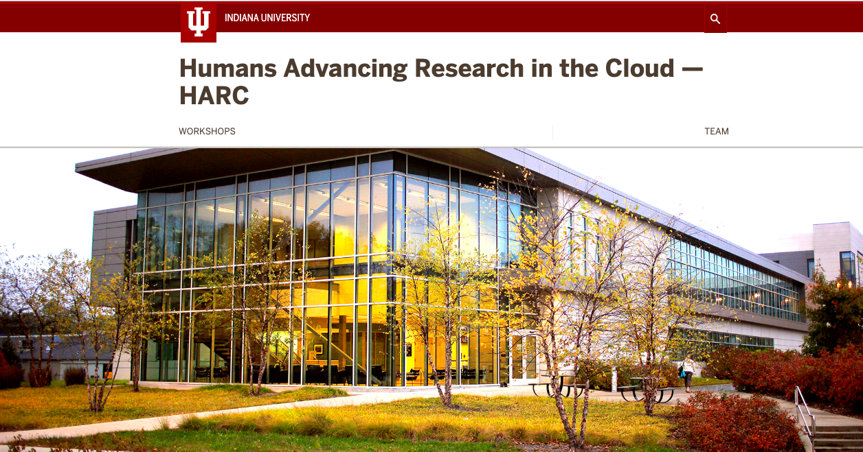
What we’re doing at Indiana University

Slide 20
There are multiple projects going now about clouds, research, and people supporting its use
NIH STRIDES (https://datascience.nih.gov/strides)
Internet2 Exploring Clouds for Acceleration of Science (E-CAS) https://www.internet2.edu/vision-initiatives/initiatives/exploring-clouds-acceleration-science/)
NSF Cloudbank (https://www.cloudbank.org)
And …
HARC (https://harc.iu.edu)

Slide 21
HARC – About the Project
Objectives:
To study and improve the understanding within the higher education community of how people in support roles advance the use of cloud-based cyberinfrastructure (CI) in the advancement of research at universities.
Establish ‘credibility’ for the topic in the academic record
To provide detail in the form of ‘return on investment’ (ROI) of the use of cloud-based CI by offering case studies on its use as compared to campus-based or existing national CI resources
Funding: A contract-based award from Microsoft Corporation. While the award is provided by Microsoft, the project entails examination and use examples of all cloud CI vendors.

Slide 22

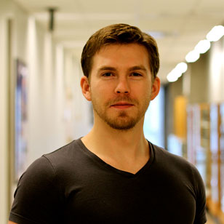

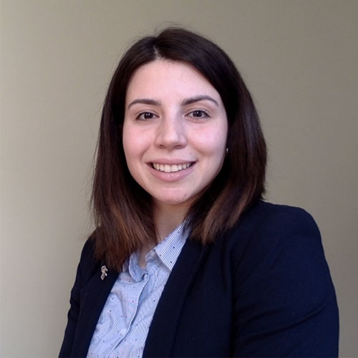



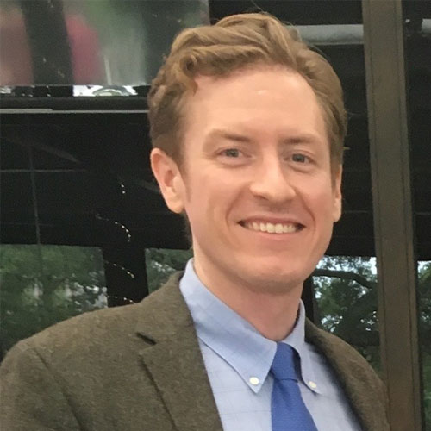
Project Phases
Phase 1: Provide support to campus-based research support engineers (post-docs, research associates) so that they may explore use of cloud services in conducting a diverse set of CI-enabled research endeavors.
Our goal was to support case-based analysis of use of the cloud for research and establish credibility of our efforts in the broader academic community by engaging in research and producing publications
Findings were presented at a workshop at PEARC19 in Chicago July 2019

Slide 23
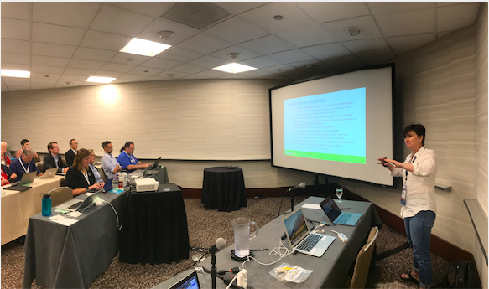
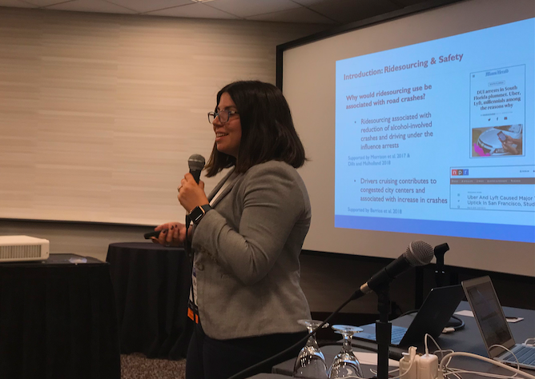
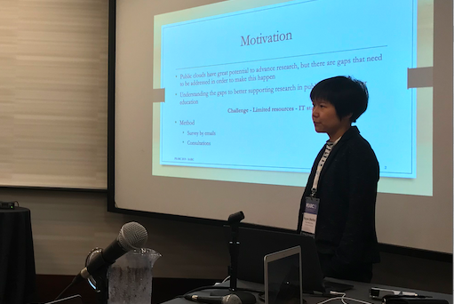
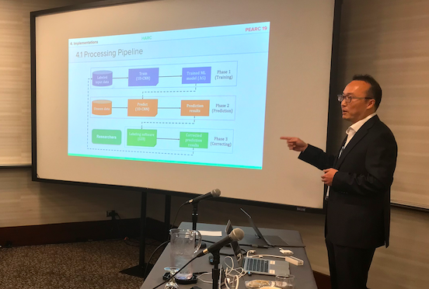
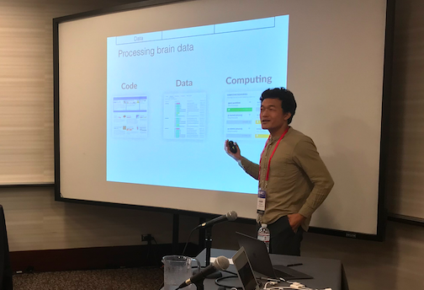
HARC Workshop at PEARC19
Peer-to-Peer style format
13 presentations on relevant projects
9 peer-reviewed papers published in the ACM digital library with open access for all
Agenda, Abstracts & Presentations available online:
harc.iu.edu/workshops/pearc19-conference.html

Slide 24
What we’ve learned so far
ROI for use of the cloud, where premise-based CI exists, is still not financially competitive
Especially true for ‘capacity’ use, less true for ‘capability’ use
The burden of learning how to make use of cloud services makes it challenging, and none of the vendors are doing an acceptable job of marketing and supporting research use
Lack of documentation and vendor support with pre-built tools
Lack of focus on researchers – more vendor focus on enterprise

Slide 25
What we’ve learned so far … continued
AWS has a substantial adoption-lead due to early entry into higher ed research; Google seems to be aggressively entering the market; Microsoft has a corporate interest but is really challenged in several ways that could inhibit success.
The importance of people is even more critical when using the cloud, due to lack of available support resources

Slide 26
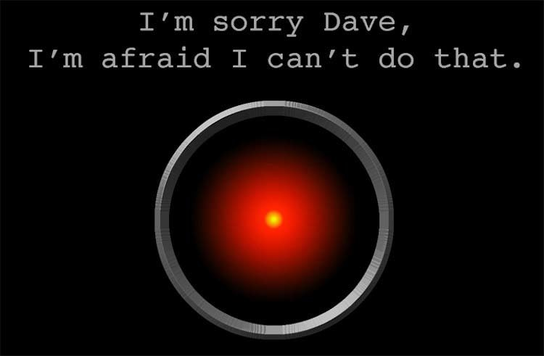
What we’ve learned so far … continued
There is significant tension that exists in institutions that have large investments in premise-based cyberinfrastructure (HPC, Storage, etc.)

Slide 27

… Significant tension that exist
Self-preservation of ‘traditional resources’ from those who provide those resources (HAL9000?)
Lack of information on ROI makes it easier for premise-advocates to deflect cloud initiatives
Vendor billing/accounting systems do not fit with acceptable approaches based upon premise, and thus discourage cloud migration

Slide 28
What we’re thinking is needed
A Leveraged Support Model in the community to advance the use of cloud services in support of research
Role of the Cloud Vendors Defined
Role of Community Resources
Tools, information, forums for exchange of ideas
Role of campus-based cloud research support engineers (CRSEs)
Awareness of researchers of cloud capabilities

Slide 29
HARC - Phase 2 Goals
Increase Awareness by further building the community and continuing support for further publication and presentation of activities in the community
Support further research endeavors under a project-based solicitation format and advance experiences with cloud CI
Support the development of an engaged community sharing experiences and detailed use-case information that will increase broader technical understanding
Provide feedback to vendors on the challenges faced by researchers attempting to make use of the cloud to replace or enhance premise-based or other available CI resources.

Slide 30
CRSE2 – Second round of research investments
Influenced by Internet2/NSF eCAS approach – larger investments, longer timeframes, interesting projects
Call for Proposals January 2020, Awards made May 2020
Arizona State University (Doug Jennewein PI, Chris Kurtz CRSE)
Georgia State University (Daniel Takabi PI, Robert Podschwadt CRSE)
University of Notre Dame (Scott Hampton PI, Matt VanderWerf CRSE)
University of Pittsburg, Pittsburg Supercomputing Center (Kim Wong PI/CRSE)
~$180K in funding to these four awardees

Slide 31
The ‘pro quo’ for our ‘quid’ of funding a CRSE
Publish in the academic record on the importance of people supporting moving CI-research to the cloud
Engage more broadly in the community of research support personnel, via outreach in peer groups, conferences, workshops, etc.
Contribute to the HARC Github repositories, in particular tools that can be used by others

Slide 32
For more information about HARC
Project related materials (papers and presentations), personnel, and workshops will be communicated via the project website:
https://harc.iu.edu
A GitHub Repo will be established (by mid-October) to share papers, presentations, use-cases, pre-built tools, and other community-supplied experiences and discussion. This will be an ecumenical resource for information supporting research in the cloud – all clouds:
https://github.com/HARC-PTI
For more information contact the HARC project leader for PTI, Brian D. Voss bvoss@iu.edu

Slide 33
Take-Away Questions to Institutional Leaders
What is your institution’s view of the importance of IT?
Does your investment and executive engagement support that view?
What are your goals for advancing research?
How does technology (cyberinfrastructure) support those goals??
Do you have a research strategy that is technology enhanced? Are you looking for local resources, collaborative efforts? Does the cloud play into your thinking?
Do you grasp the importance of people in supporting research using technology?

Slide 34
Questions? Comments? Discussion?

Slide 35
